Slide 1
Hospital Readmission Risk Prediction

Slide 2



Problem Statement
Readmissions which are unplanned within 30 days which is a costly issue in medical care
Interventions that lower readmission rates, save expenses, and enhance results are made possible by early and precise prediction.
Objective: Create a machine learning model that can be interpreted to forecast readmission risk at discharge.

Slide 3

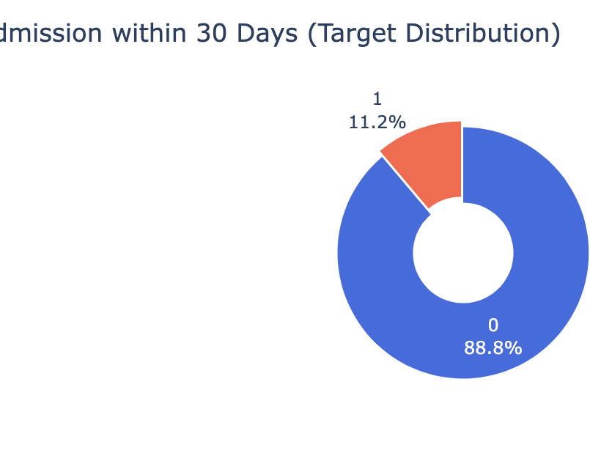
Data Overview
Dataset: Real hospital EHR records, thousands of inpatients.
Features include demographics, diagnosis codes, lab results, medications, comorbidities, prior utilization, admission/discharge info.
Readmission rate is low (high class imbalance).

Slide 4
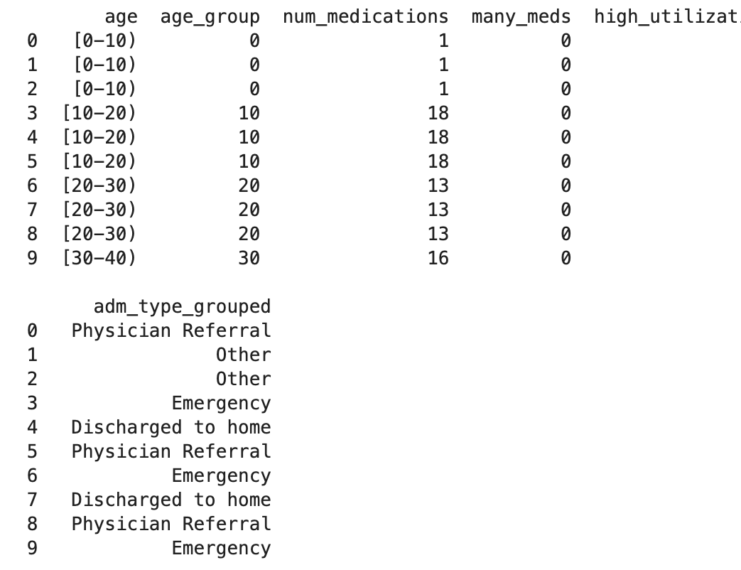
Exploratory Data Analysis & Feature Engineering
Imputed missing values and grouped rare categories for stability.
Created new features: age bins, “many_meds”, “high_utilization”, grouped admission types, comorbidity flags.
Examined distributions, correlation, and class imbalance.

Slide 5

Modeling Pipeline
Preprocessing here involves categorical encoding, numerical imputation, and scaling.
SMOTE balanced the training data due to high class imbalance.
The models compared and trained consisted of XGBoost, RandomForest, Logistic Regression, and a Stacking Ensemble.
Cross-validation was used to select robust models.

Slide 6
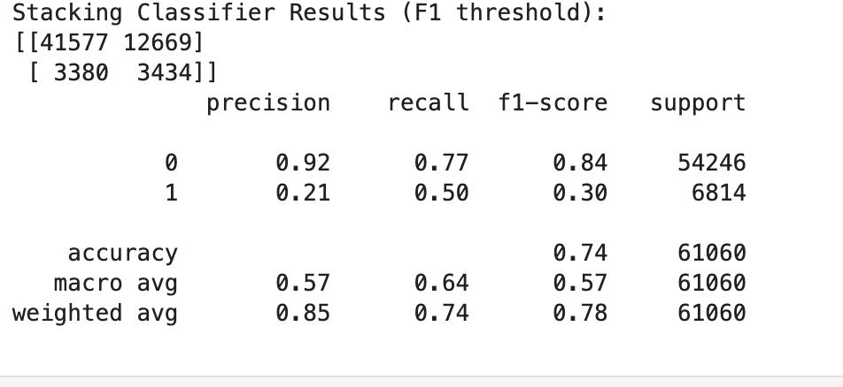
Metrics
Recall: The fraction of all true readmissions that we identify. High recall = fewer missed high-risk patients.
Precision: Of the patients predicted to be readmitted, how many really are? High precision = fewer false alarms.
F1-score: The harmonic mean of recall and precision. Maximizes balance between missing a risk (recall) and causing false alarms (precision).
In healthcare, both missing real cases (low recall) and overwhelming clinicians with false positives (low precision) can be costly.

Slide 7
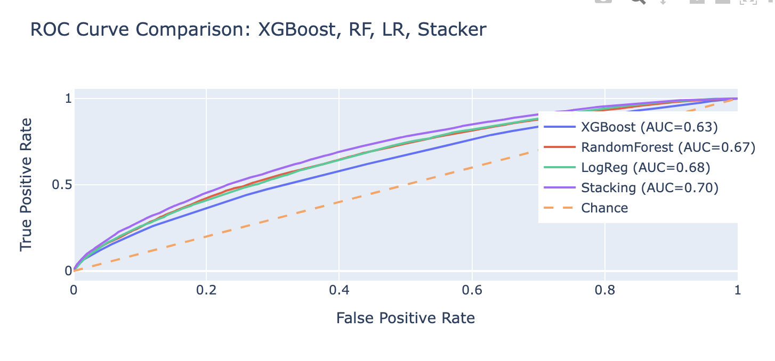
AUC & F1 Performance
Evaluated models on ROC-AUC, precision, recall, and F1.
[Insert ROC curve plot for visual comparison, showing stacking ensemble best.]
Best model: Stacking Ensemble (AUC = 0.70), offering a good balance and better utility than individual models.

Slide 8
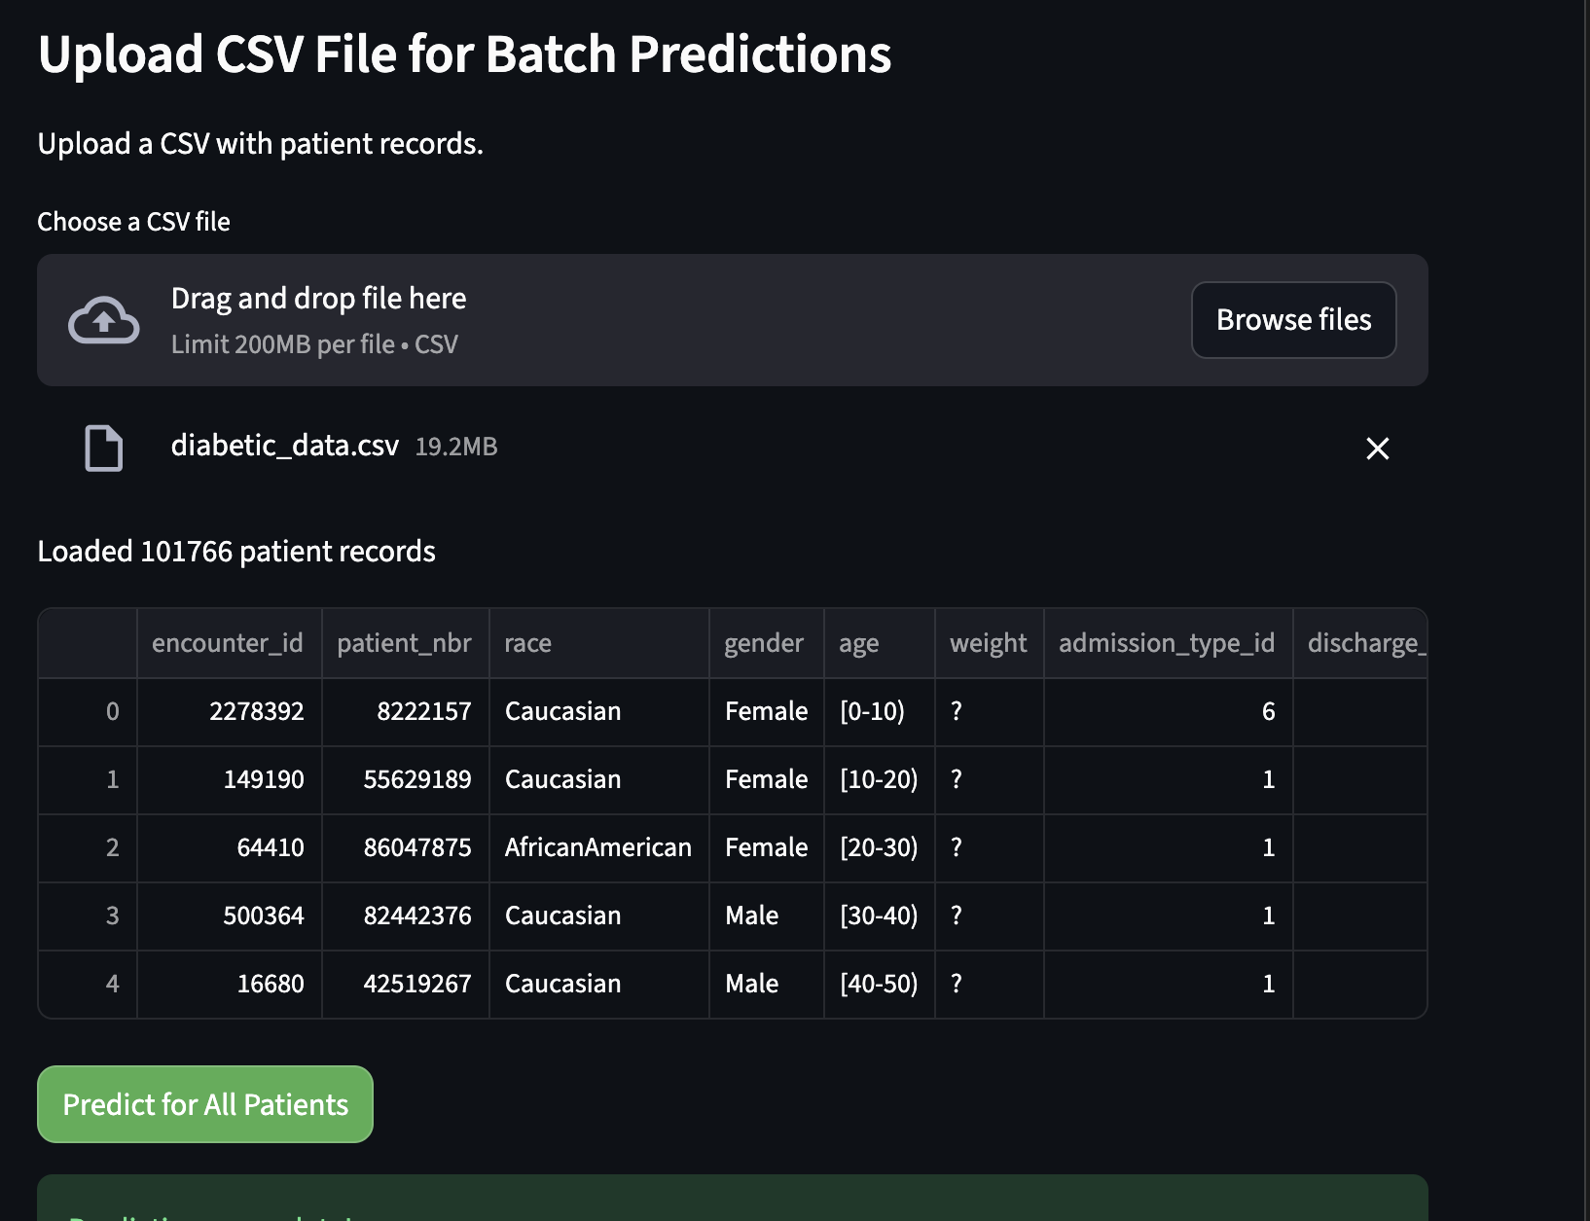
Deployment and App Overview
Built a Streamlit web app for clinical use.
Accepts user or batch CSV input with major high-impact features.

Slide 9
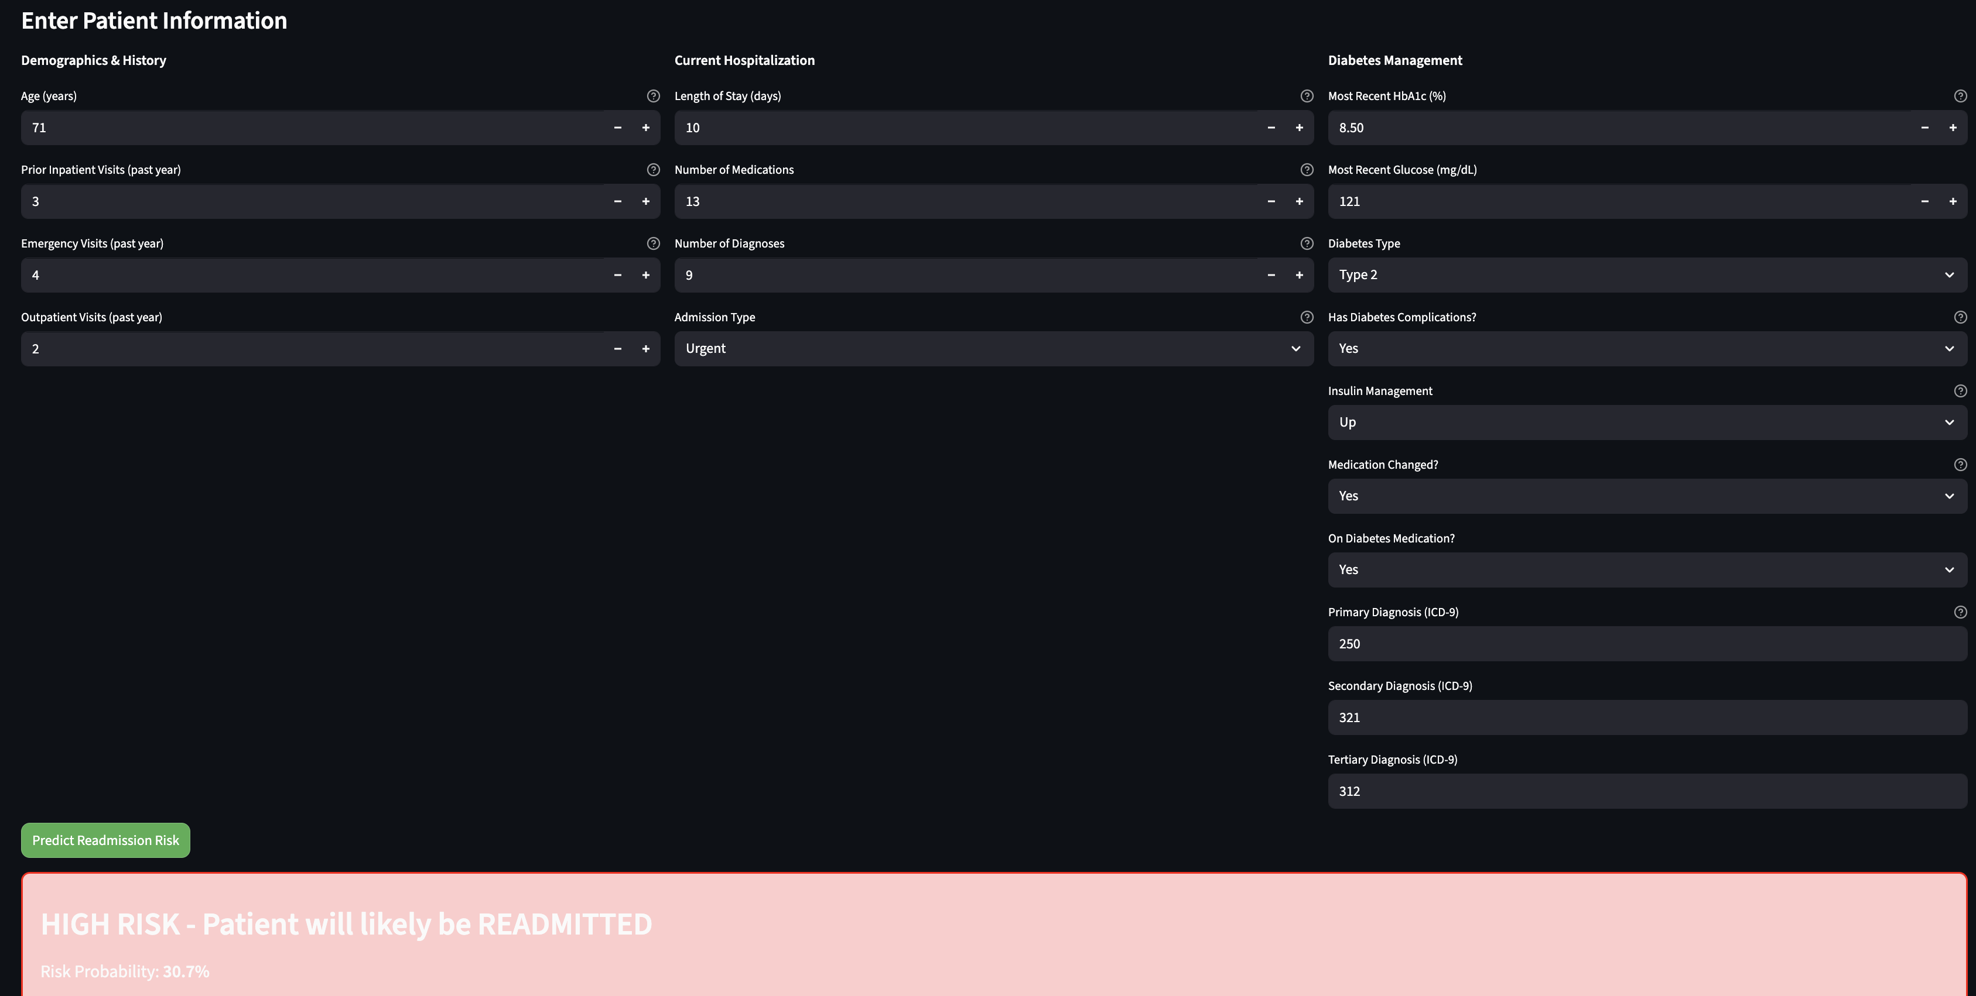
Deployment and App Overview
Outputs actionable “high risk” or “low risk” classifications plus probability.
Enables clinicians to quickly identify and intervene with at-risk patients.

Slide 10


Thank you

